Slide 1
Image Scan Holdings plc
Annual General Meeting 2020
William Mawer - Chairman
February 2020

Slide 2
Agenda
PRESENTATION
QUESTIONS
RESOLUTIONS PUT BEFORE THE MEETING
FACILITY TOUR AND SYSTEM DEMONSTRATIONS

Slide 3
These presentation slides (the “Slides”) have been issued by Image Scan Holdings Plc (the “Company”) in relation to its Annual General Meeting on 25 February 2020
The Slides have been prepared by and are the sole responsibility of the Company. Although all reasonable care has been taken to ensure that the facts stated in the Slides and accompanying verbal presentation are true and accurate to the best of the directors' of the Company (the “Directors”) knowledge, information and belief and that the opinions expressed are fair and reasonable, no representation, undertaking or warranty is made or given, in either case, expressly or impliedly, by the Company or any of its subsidiaries or Cantor Fitzgerald Europe (“Cantor”) or any of their respective shareholders, directors, officers, employees, advisers or agents as to the accuracy, fairness, reliability or completeness of the information or opinions contained in the Slides or the accompanying verbal presentation or as to the reasonableness of any assumptions on which any of the same is based or the use of any of the same. Accordingly, no such person will be liable for any direct, indirect or consequential loss or damage suffered by any person resulting from the use of the information or opinions contained herein (which should not be relied upon), or for any opinions expressed by any such person, or any errors, omissions or misstatements made by any of them, save in the event of fraud or wilful default. Prospective investors are encouraged to obtain separate and independent verification of information and opinions contained herein as part of their own due diligence.
The Slides have not been approved by an authorised person for the purposes of section 21 of the Financial Services and Markets Act 2000 (as amended) (“FSMA”). In the United Kingdom, the Slides are exempt from the general restriction in section 21 of FSMA on the communication of invitations or inducements to engage in investment activity pursuant to the Financial Services and Markets Act 2000 (Financial Promotion) Order 2005 (the “Financial Promotion Order”) on the grounds that it is directed only at the following, being persons who the Company reasonably believes to be: (a) persons having professional experience in matters relating to investments (being “Investment Professionals” within the meaning of article 19(5) of the Financial Promotion Order); (b) persons who fall within article 49 of the Financial Promotion Order (high net worth companies, unincorporated associations, or partnerships or the trustees of high value trusts), or (c) other persons who have professional experience in matters relating to investments and to whom the Slides and accompanying verbal presentation may otherwise be lawfully communicated (all such persons together being referred to as “Relevant Persons”). By attending the presentation of the Slides, you represent and warrant that you are a Relevant Person. The content of the Slides is only available to Relevant Persons, and is not to be disclosed to any other person of any other description, including those that do not have professional experience in matters in relation to investments, and should not be used for any other purpose, and any other person who receives the Slides should not rely or act upon them. Any investment or investment activity or controlled activity to which the Slides relates is available only to such Relevant Persons and will be engaged in only with such Relevant Persons. Reliance on the communication set out in the Slides for the purpose of engaging in any investment activity may expose an individual to a significant risk of losing all of the property invested or of incurring additional liability. Any individual who is in any doubt about the investment to which the Slides relate should consult an authorised person specialising in advising on investments of the kind referred to in the Slides.
The distribution of the Slides in other jurisdictions may be restricted by law and persons into whose possession the Slides come should inform themselves about, and observe, any such restrictions. Any failure to comply with these restrictions may constitute a violation of the laws of any such other jurisdictions. The Slides are not for distribution outside the United Kingdom and, in particular, the Slides or any copy of them should not be distributed, published, reproduced or otherwise made available in whole or in part by recipients to any other person, directly or indirectly, by any means (including electronic transmission) either to persons with addresses in Canada, Australia, Japan, the Republic of South Africa and the Republic of Ireland or to persons with an address in the United States, its territories or possessions or to any citizens, nationals or residents thereof, or to any corporation, partnership or other entity created or organised under the laws thereof, or any other country outside the United Kingdom where such distribution may lead to a breach of any legal or regulatory requirement. Any such distribution could result in a violation of Canadian, Australian, Japanese, United States, South African or the Republic of Ireland law. By attending the presentation and/or accepting the Slides, you agree to keep permanently confidential the information contained herein or sent herewith or made available in connection to with further enquiries unless and until it comes into the public domain through no fault of your own and the Slides are being supplied solely for your information. The Slides may not be copied, reproduced or distributed, in whole or in part, to others or published at any time without the prior written consent of the Company and Cantor. Without prejudice to the foregoing, neither the Company, Cantor nor its advisers, nor its representatives accept any liability whatsoever for any loss howsoever arising, directly or indirectly, from use of the Slides or its contents or otherwise arising in connection therewith.
The information and opinions contained in the Slides and accompanying verbal presentation are provided as at the date of this presentation and are subject to change without notice. Save as otherwise expressly agreed, none of the above should be treated as imposing any obligation to update or correct any inaccuracy contained herein or be otherwise liable to you or any other person in respect of any such information. In particular, and without limitation, nothing in the Slides and accompanying verbal presentation should be relied on for any purpose.
The Slides and the accompanying verbal presentation contain certain forward-looking statements and projections. These statements relate to future events or future performance and reflect the Directors’ and management's expectations regarding the Company’s growth, results of operations, performance and business prospects and opportunities. Such forward-looking statements reflect the Directors and management’s current beliefs and are based on information currently available to the Directors and management and are based on reasonable assumptions as at the date of this presentation. Such forward-looking statements involve known and unknown risks, uncertainties and other important factors beyond the control of the Company, the Directors or management that could cause actual performance or achievements or other expectations expressed to be materially different from such forward-looking statements. No assurance, however, can be given that the expectations will be achieved. While the Company makes these forward-looking statements in good faith, neither the Company, nor its Directors and management, can guarantee that the anticipated future results will be achieved and accordingly, you should not rely on any forward-looking statements and the Company accepts no obligation to disseminate any updates or revisions to such forward-looking statements.
Cantor is the Company’s Nominated Adviser and Broker and is advising the Company and no one else and will not be responsible to anyone other than the Company for providing the protections afforded to customers of Cantor. Any other person should seek their own independent legal, investment and tax advice as they see fit. Cantor’s responsibilities as the Company’s Nominated Adviser under the AIM Rules will be owed solely to London Stock Exchange plc and not to the Company, to any of its Directors or any other person in respect of a decision to subscribe for or acquire shares or other securities in the Company. Cantor has not authorised the contents of, or any part of, the Slides for the purposes of section 21 of FSMA and no representation or warranty, express or implied, is made as to any of the Slides contents.
By agreeing to receive the Slides and continuing to attend the presentation to which they relate you: (i) represent and warrant that you are a Relevant Person and (ii) agree to the foregoing (including, without limitation, that the liability of the Company or Cantor and their respective directors, officers, employees, agents and advisors shall be limited in the manner described above.
IF YOU ARE NOT A RELEVANT PERSON OR DO NOT AGREE WITH THE FOREGOING, PLEASE IDENTIFY YOURSELF IMMEDIATELY.

Slide 4
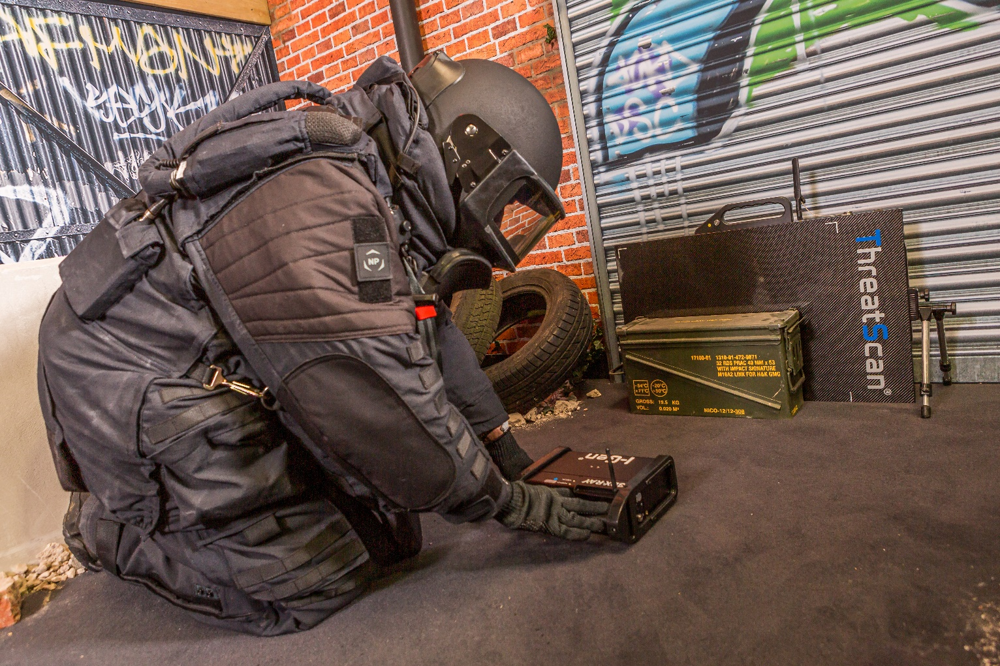
Introduction to Image Scan Holdings plc
Developer and manufacturer of X-ray inspection systems
Currently focussed on two distinct markets
    Portable X-ray for security and bomb detection
    Industrial inspection for automotive emission control
90% of sales overseas
Expanding product range
18 staff based in Loughborough, UK
Bomb technician using portable X-ray

Slide 5
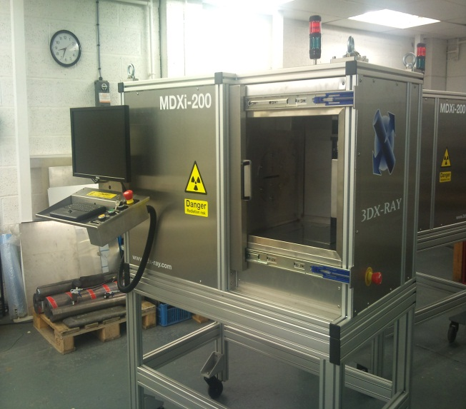
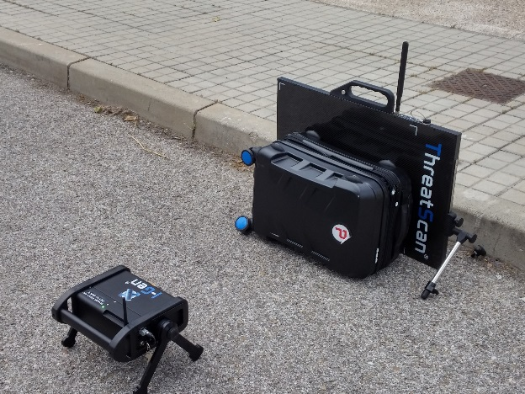
Our primary business areas
Portable X-ray inspection systems
X-ray threat detection systems for:
  bomb technicians
  prisons
  customs
  Government sales through international partners
Industrial X-ray inspection systems
X-ray inspections systems for catalytic converters and diesel particulate filters
Key account sales to global automotive customers
  Low volume: currently <10 units per year
  Strong support revenue
Favourable payment profiles in both sectors minimise working capital requirements

Slide 6
Image Scan’s performance
Financial Years | 2015 | 2016 | 2017 | 2018 | 2019
Sales | £1.7m | £3.3m | £5.0m | £3.5m | £2.4m
GP% | 38% | 42% | 39% | 48% | 54%
Overheads | £1.3m | £1.4m | £1.5m | £1.6m | £1.7m
EBIT | (£640k) | £105k | £477k | £96k* | (£403k)*
FY 2019
Order intake: £3.9m
Year end position:
  Order book: £1.7m
  Cash: £640k
* Note:
A £1m order was cancelled in February 2018. Impacted 2018 and 2019 sales
2018 loss of £200k after exceptional costs related to an aborted acquisition

Slide 7
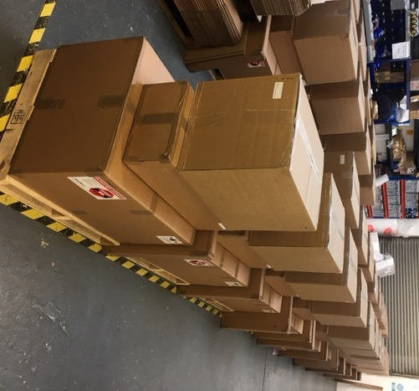
Key business aims for 2020 and beyond
Deliver projects won late in FY19
Maintain order intake momentum
Continue to strengthen current products
Expand product range
  Internal development
  Partnership
Expand into North America
Position for future acquisitions
Portable X-ray order waiting for dispatch

Slide 8
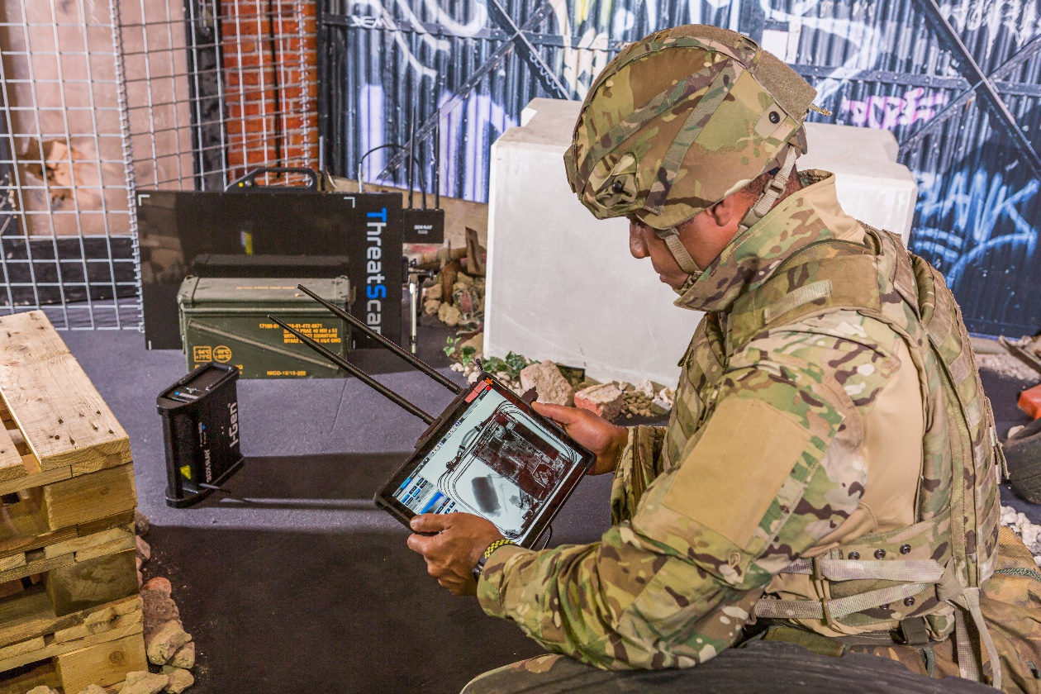
Continue to strengthen products
Continued innovation of portable X-ray product range
Examples include:
Communications range extension
Improved detectors and generators
Enhanced image processing tools
Wider deployment options
We will continue to tailor systems to a wide range of operation requirements

Slide 9
Expanding the product range
New security development project
New X-Ray inspection system for scanning bags, personal effects and mail
Market: Government and commercial buildings, prisons
Based on current hardware/software technology
Will go to market through existing partners
Prototype has produced first image
Launch early in FY2020 H2

Slide 10
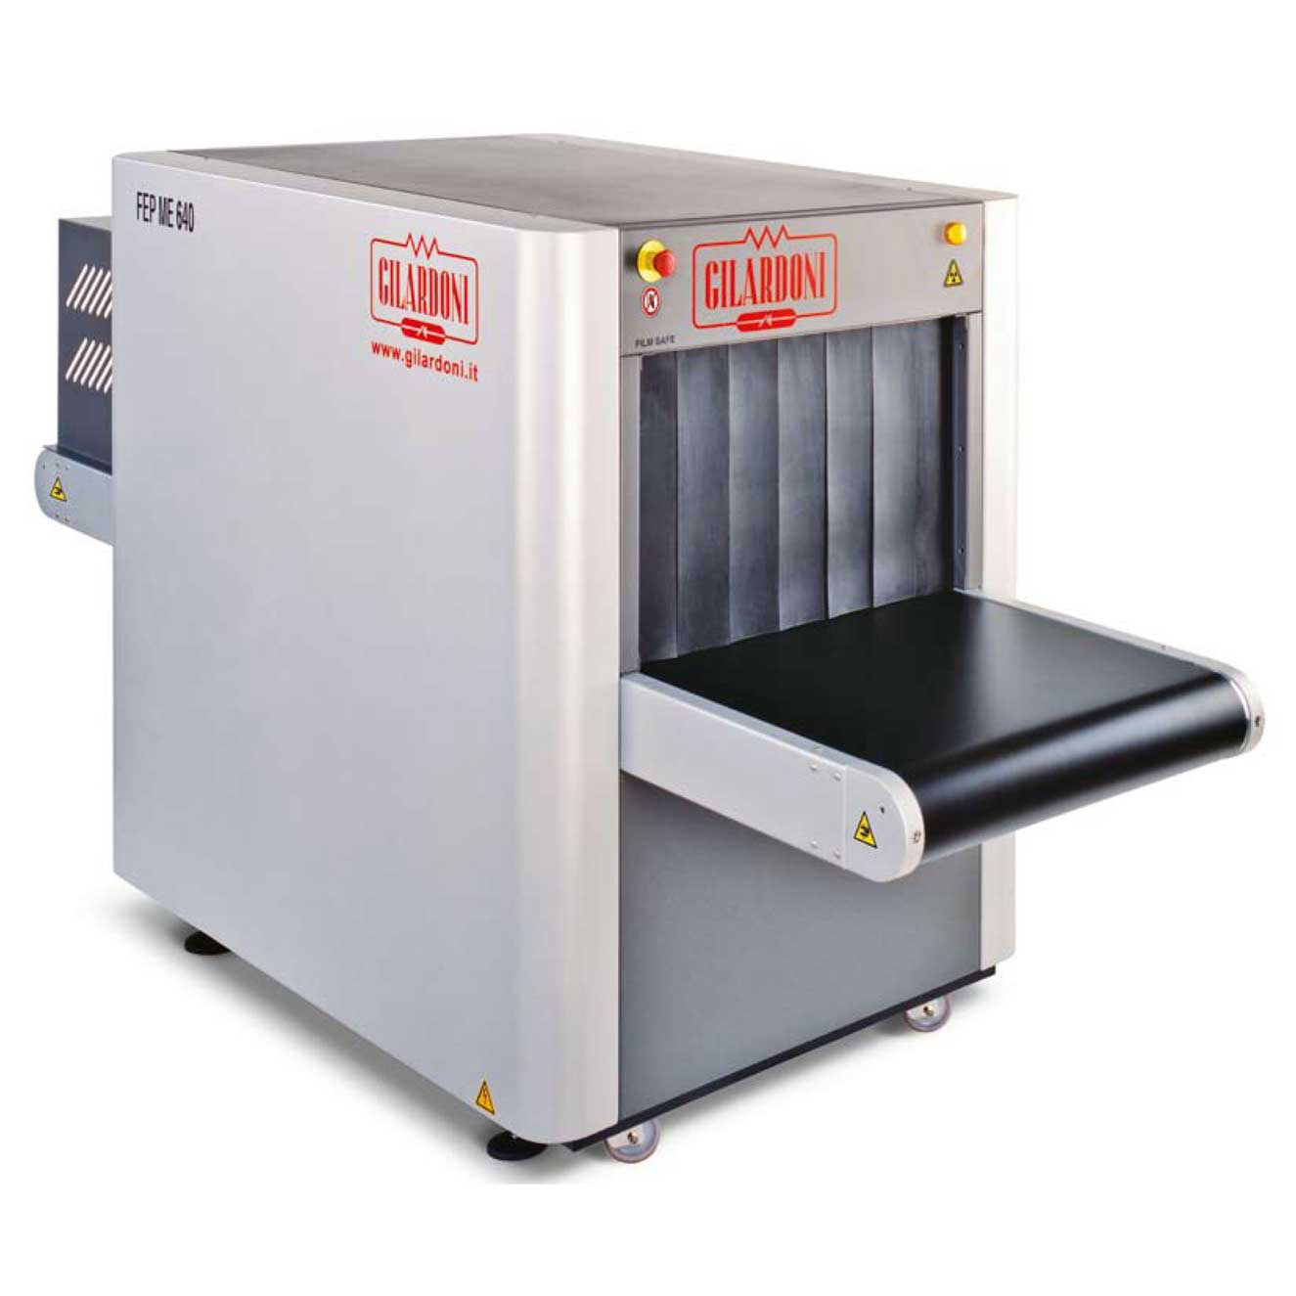
Expanding the product range
New partnerships
UK distribution agreement signed with Gilardoni, leading Italian X-ray company
  Significant UK installed base with opportunities to expand
  Potential for service revenue
Working with potential suppliers for replacement of Axis conveyor X-ray product range
  Export markets through extended distributor network
Looking to add partnership agreements for 3rd party threat detection and analysis systems

Slide 11
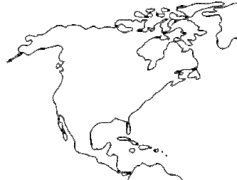
North American market
Target: state and local bomb squads
  Cost effective upgrade to old technologies
New sales consultant – John Howell
  Ex US Marine senior bomb technician
  Educator on threat detection and identification
  Already strong advocate for ISH technology
  Will also support new product development

Slide 12
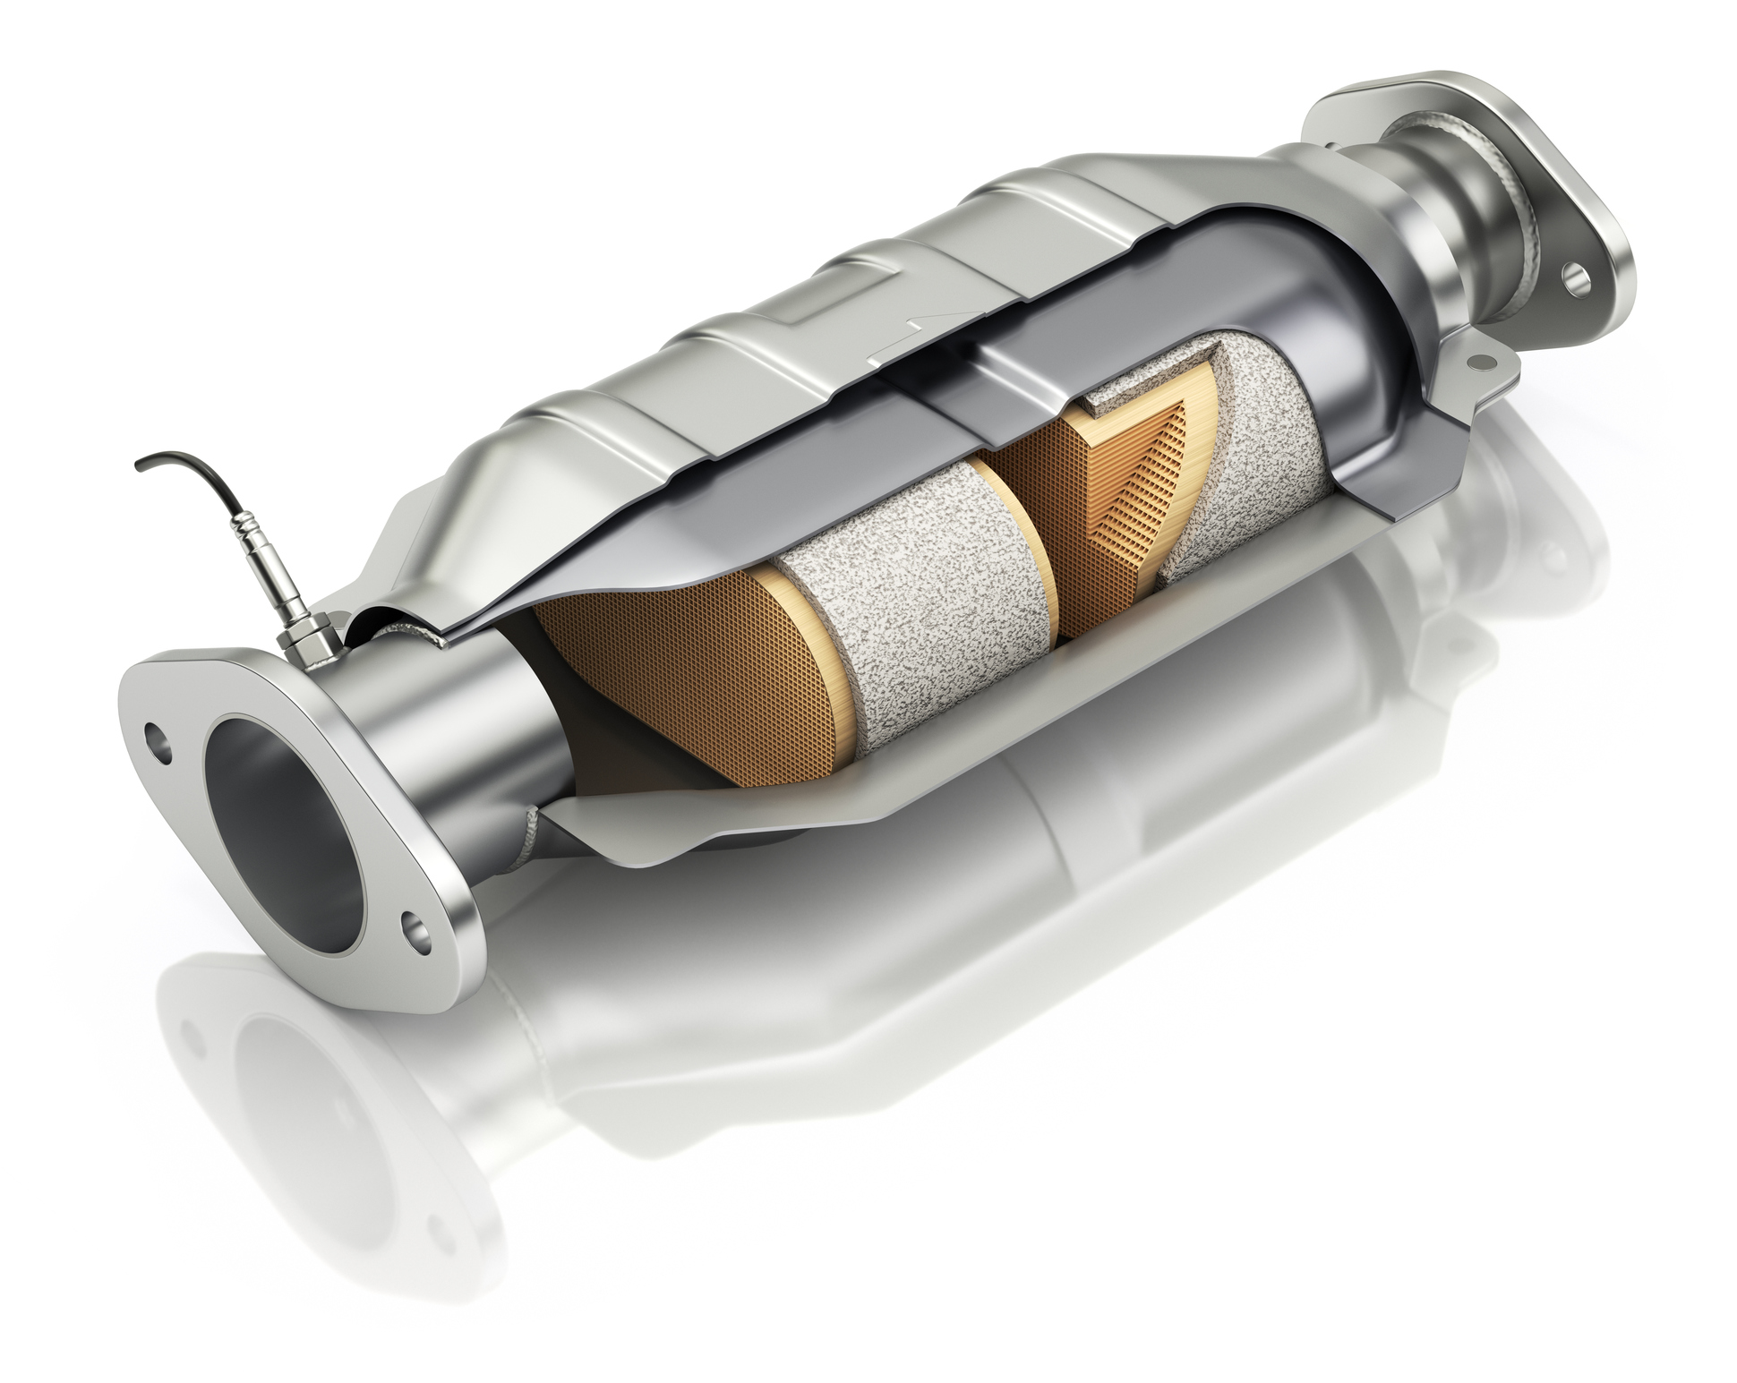
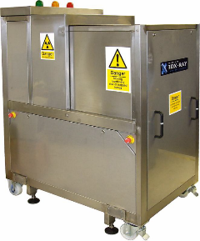
Industrial - inspection
We non-destructively inspect catalytic converters and diesel particulate filters
THE MARKET
Well defined niche – now adopting X-ray imaging
Blue Chip automotive customers
Growing emphasis on clean emissions and quality control (especially In India/China)
IMAGE SCAN POSITON
Installed base of c50 machines – good service revenue
Little competition – high barriers of entry
New customers starting global deployment
CURRENT FOCUS
Accelerated deployment by existing customers
Recruit new customers
New applications in same sector
Typical catalytic converters
In-line X-Ray

Slide 13
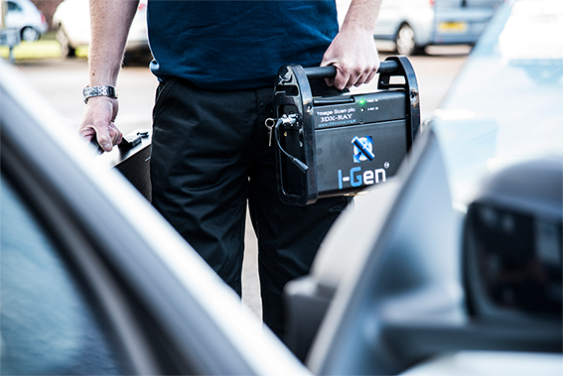
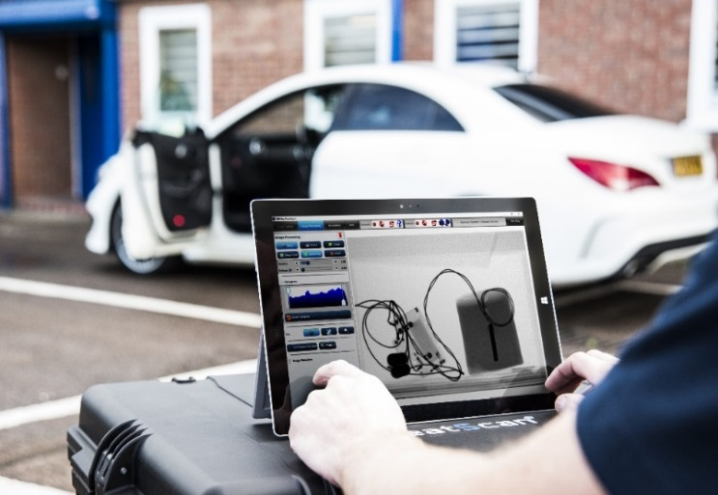
Summary
Strong product pipeline and new customers
Opportunities for growth
Management remain ambitious and committed

